Slide 1
Digital Portfolio
STUDENT NAME: PREETHEESWARI.J
REGISTER NO AND NMID: asunm1451222407510
DEPARTMENT:B.SC COMPUTER SCIENCE
COLLEGE: MAHALASHMI WOMEN’S COLLEGE OF ARTS AND SCIENCE
(UNIVERSITY OF MADRAS)

Slide 2
PROJECT TITLE
Digital Portfolio

Slide 3


AGENDA
Problem Statement
Project Overview
End Users
Tools and Technologies
Portfolio design and Layout
Features and Functionality
Results and Screenshots
Conclusion
Github Link
3/21/2024 Annual Review

Slide 4

PROBLEM STATEMENT
Digital portfolios are personal websites that allow you to electronically collect your work over time, reflect upon your personal and academic growth, and then share selected items with others, like professors, advisors, and potential employers

Slide 5

PROJECT OVERVIEW
*Creates an online showcase of an individual’s best work, skills, achievements, and experience using multimedia elements like text, images, and videos to present a holistic and personalized professional story to potential employers, clients, or collaborators.
* This dynamic, interactive collection serves as a powerful tool for personal branding, self-marketing, and demonstrating capabilities, offering a richer, more engaging view of a person’s abilities than traditional resumes alone.

Slide 6

WHO ARE THE END USERS?
The primary end users of a digital portfolio are students and professionals in creative and technical fields, such as writers, photographers, graphic designers, developers, architects, and teachers, who use it to showcase their skills, projects, and qualifications to potential employers, clients, or academic institutions.

Slide 7

TOOLS AND TECHNIQUES
To create a compelling digital portfolio, select the right tools like website builders (Wix, Squarespace, Adobe Portfolio) or specialized platforms { Canva, GitHub, Issuu }

Slide 8
POTFOLIO DESIGN AND LAYOUT
A successful digital portfolio relies on a clean, intentional design that prioritizes showcasing your best work effectively. Your design and layout should be easy to navigate, visually consistent, and tailored to your specific creative field.
8

Slide 9
FEATURES AND FUNCTIONALITY
Content presentation Case studies: For designers, marketers, and developers, detailed case studies that explain the context and results of a project are crucial. A good case study should outline the problem, your approach, and the measurable outcome. High-quality media: Whether images, videos, or audio, all media should be high-resolution and optimized for quick loading times to ensure a smooth user experience on any device. Project filtering and categorization: If you have extensive or diverse work, a filtering system allows visitors to quickly find projects relevant to their interests (e.g., filtering by project type, industry, or medium). Interactive elements: Prototypes: Designers should embed interactive prototypes from tools like Figma or Adobe XD to allow users to directly experience their work. Micro-animations and hover effects: Subtle animations on project cards or navigation links add a dynamic and modern feel to your site, making it more engaging than a static presentation. Video showreels: For filmmakers, animators, or visual artists, a video showreel or embedded clips provide an immersive and dynamic demonstration of skills. Usability and performance Responsive design

Slide 10
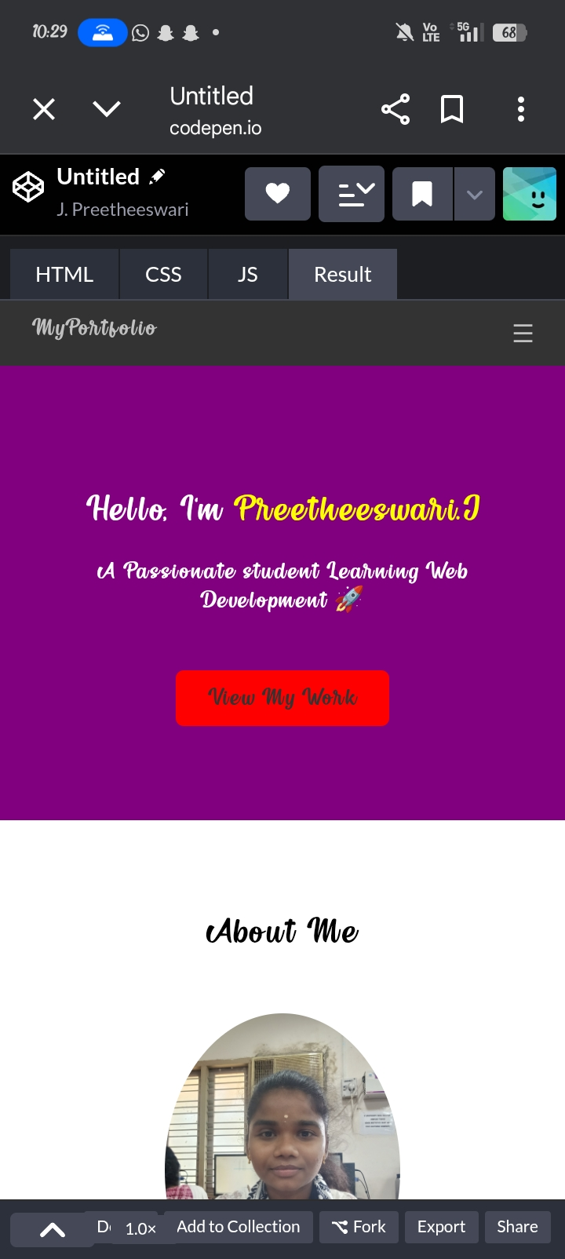

RESULTS AND SCREENSHOTS
3/21/2024 Annual Review
10

Slide 11
CONCLUSION
A powerful conclusion for a digital portfolio serves as a final, memorable statement that summarizes your identity and purpose. Beyond just wrapping up, it should reinforce your value and guide the reader toward a clear next step, transforming a casual visit into a potential opportunity.
11

